Slide 1
Bookkeeper App
By Luca Dejesu, Miranda Flemming, Shreya Gazawada, Andy Shao, Vaibhav Sharma, Danh Vo, Jonathan Wachholz
Notes:
Welcome to the presentation everyone!
Today we in Group 9 are here to present our development plan for the Bookkeep application!
My name is Jonathan Wachholz, and the rest of the team here will be walking you through our plan for the beginning of the Bookkeeper app.

Slide 2
Outline
Features
Organize your book / text files
Read them in a nice format
Later feature -->
Turn any document into an AudioBook!
Notes:
The bookkeeper app is meant to be a way that someone can organize their book files in one place and view them in a readable format.
Whether it be managing your textbook collection or keeping track of text documents, the bookkeeper can be used.
One of the future features that can set this project apart from the rest will be the ability to Translate any of the eBooks in your database into audio, essentially turning any eBook into an audio book.
Here we will go over our development plan for the Bookkeeper app, including Cost and Time Estimates, the Project Requirements, as well as the use cases that should be met by the end of the projects first development cycle.

Slide 3
Cost, Effort, and Pricing Estimation
We use a functional point method to determine a basis for cost and effort.
We mainly have internal processing.
The most important thing is the ease and enjoyment of the user.

Slide 4
Hardware cost estimation
Developing a multi-platform application requires multiple devices
IPhone SE, Pixel 4a, Macbook Air, Google One cloud backup
Emphasis on portability, cost for performance, and data redundancy
Total cost for team of 5 Developers: $8444.94
Notes:
We want to develop for multiple platforms, so we need multiple test devices to cover Android, iOS, macOS, and Windows development.
We chose the iPhone SE, retailing for $399 because it has all the necessary features, supports the latest iOS version, and is the most cost effective option.
For Android testing, we chose the $349 Pixel 4a for the same reasons, and because we need to work with a pure version of Android, so we don't run into unexpected problems arising from a manufacturer-customized version of Android, and to maintain greatest compatibility with all target devices.
For general development, macOS, and Windows testing we chose Macbook Airs, retailing at $929 to accommodate remote work, portability, and to cut costs by developing on a single device that can run macOS and Windows
Finally, as a cloud backup solution for development assets, we chose Google One because of competitive pricing, reliability, and ease of use
For a team of 5, the total cost for 5 of each device and 5 Google One subscriptions comes out to $8444.94

Slide 5
External Factors to Consider
Organization of the books
Group delegation and expertise
Future development support

Slide 6
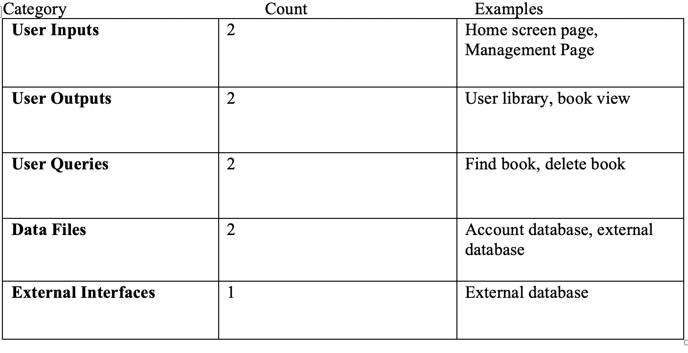
Category Counts
We have 3 simple complexity categories, and 2 average complexity:

Slide 7
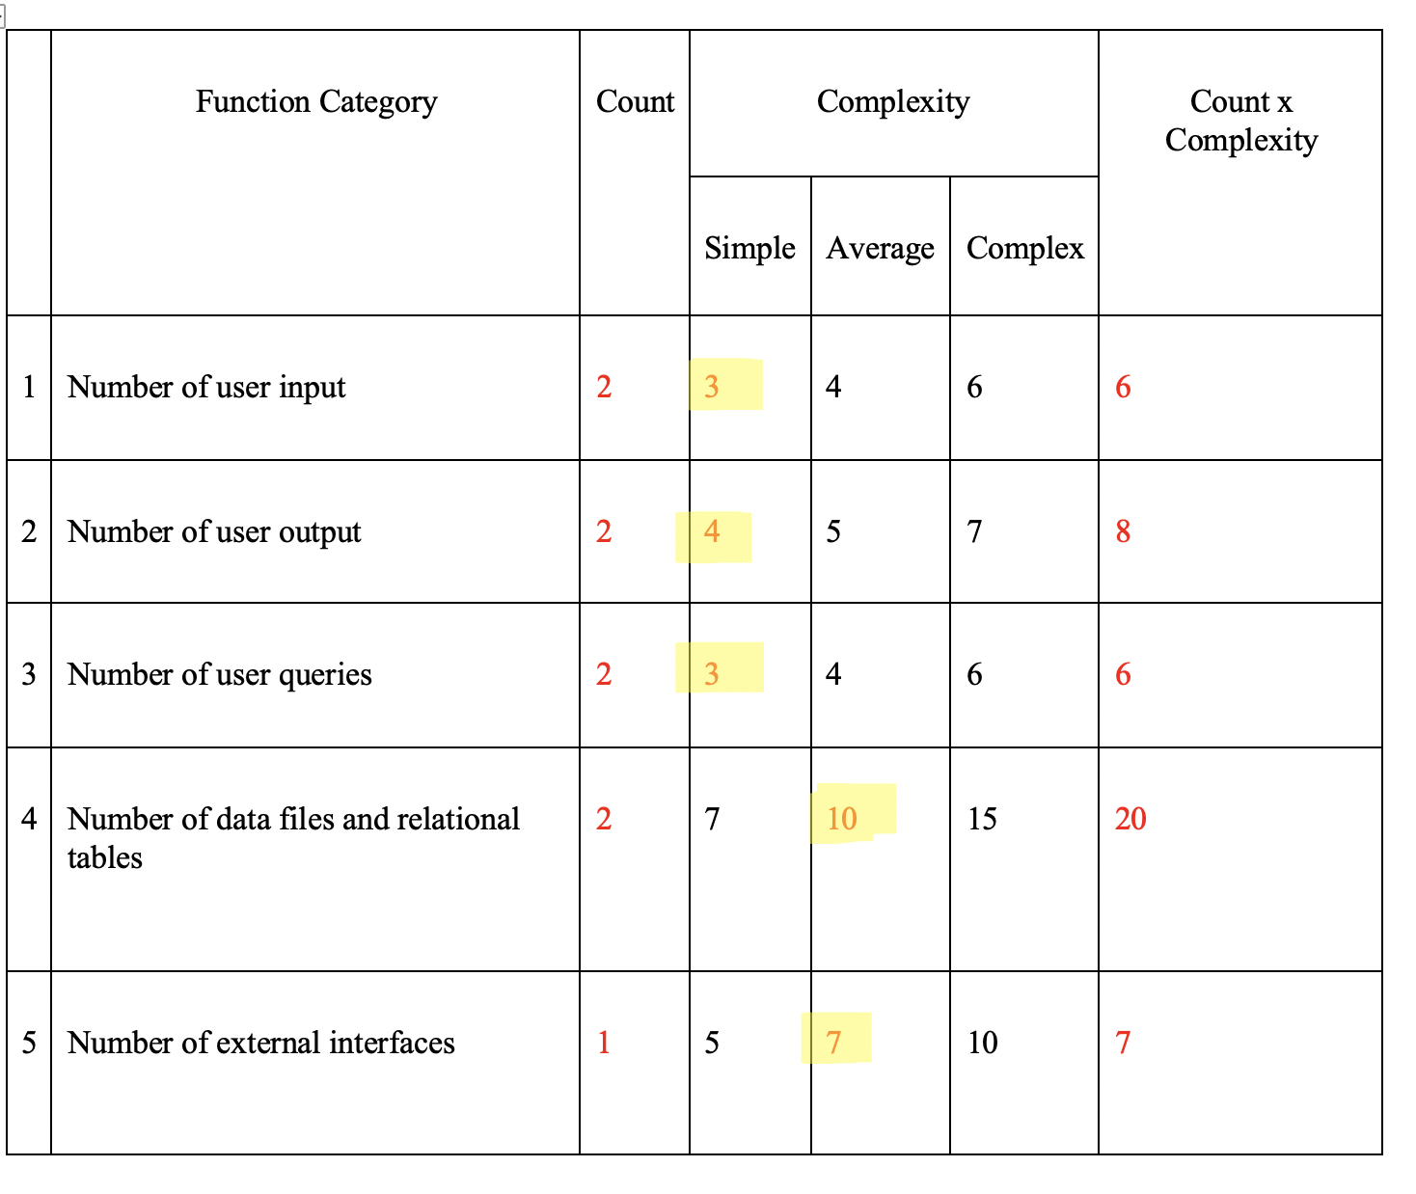
Computing the Function Points
We end with gross function points of 47
We calculate the processing complexity adjustment or PCA as 0.86
This gives us a FP of
47 x 0.86 = 40.42

Slide 8
Function points for Duration and Effort
Effort = Function Points/Productivity of the Team per week
5 team members, 40.42 function points
15 function points per week
Effort, E = 40.42/15 = 2.695 or about 3 person-weeks
Duration = 3 person-weeks/5 people = 0.6 weeks or about 1 week, however we estimate 2 weeks of testing.
3 total weeks for production

Slide 9
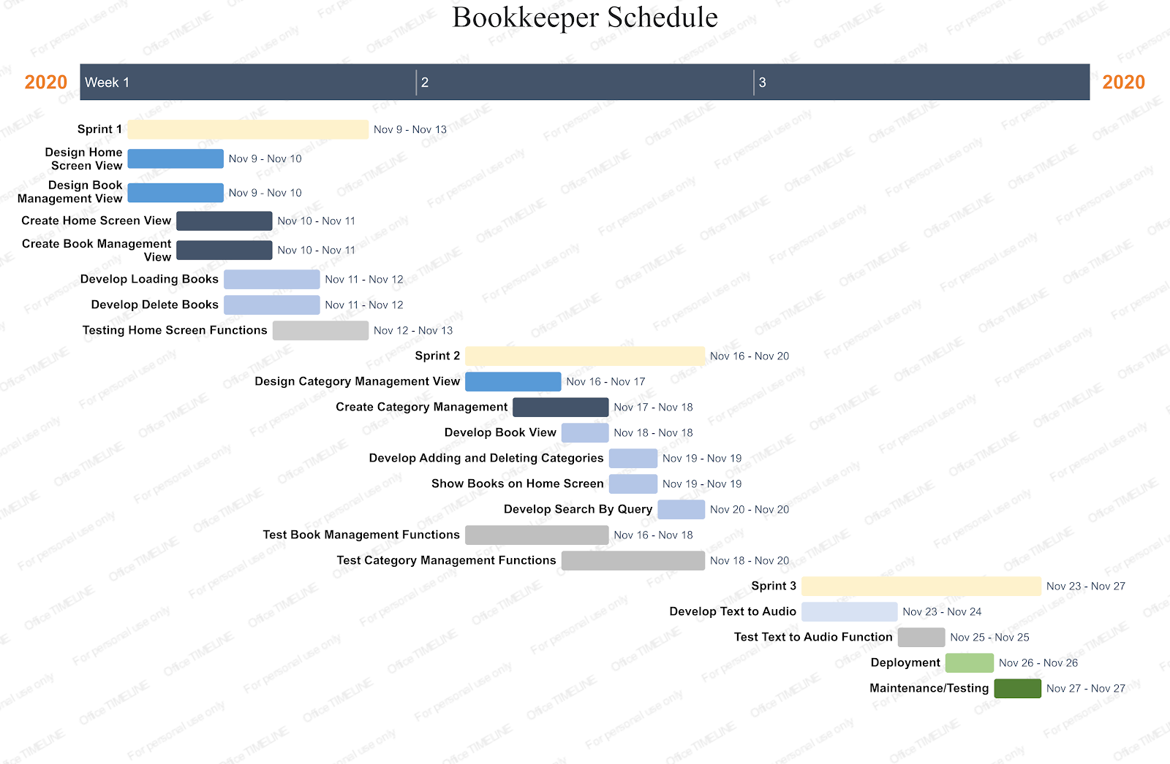
Project Timeline

Slide 10
Functional Requirements
The user must be able to...
Load eBooks into the database
Delete books from the database
Add categories to books in the database
Delete categories from books in the database
Search within books via text queries

Slide 11
Non-Functional Requirements
Usability: clean and intuitive UI
Performance: fluid, instantaneous scrolling, elegant animation
Dependability: no Internet requirement, low footprint, gracefully and quickly handle any crashes
Notes:
Aesthetically, we want to create a minimalist, uncluttered UI, making the book the focus.
With regards to performance, no intensive computation is involved. In-book operations such as scrolling and page-turning animations should be elegant and short, with no noticeable lag. Loading and deleting books in the library should be similarly instantaneous, with large operations over multiple books taking only a few seconds.
Since our core application has no connectivity requirement, it should be stable and highly available, the application should use minimal system resources, since it handles relatively small files. In the event of a crash, the user should be gracefully notified, the user’s data backed up, and the application should be restarted, all within 5 seconds.

Slide 12

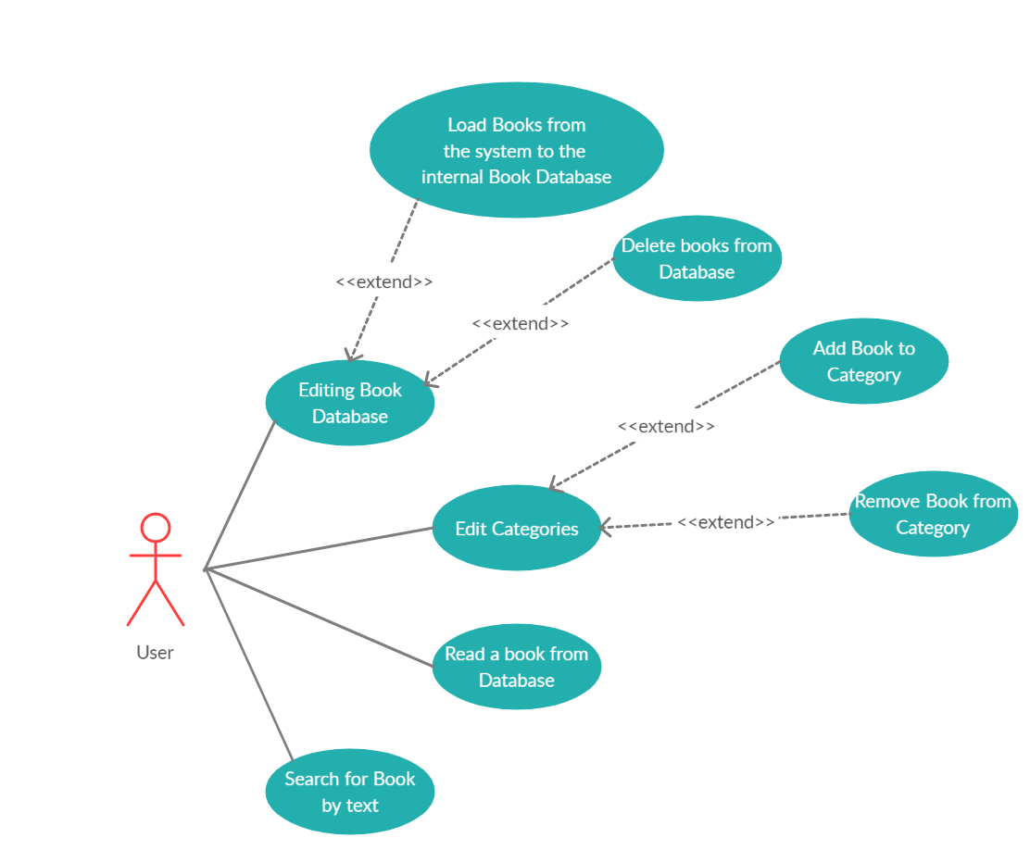
Use Case Diagram
4 main actions:
Adding/Removing a book from the Database
Adding/Removing a book from the Categories list
Viewing a book
Searching for a book
Notes:
Our goal for the beginning development of this project is to get the most basic uses for a book reader done.
First the user must be able to add books from their system into the Bookkeepers database and remove them.
From here, they will be able to open up one of the books and read it in a viewable format.
More viewing options will be added later, but for now it will just be a basic windowed display of the text contents of the book.
We also want to get another feature of being able to create custom lists from the books so you can categorize your books further.
This would be something similar to creating tags or genres for books.
And once we have all that we want to be able to search for a book by its title and other category tags.

Slide 13
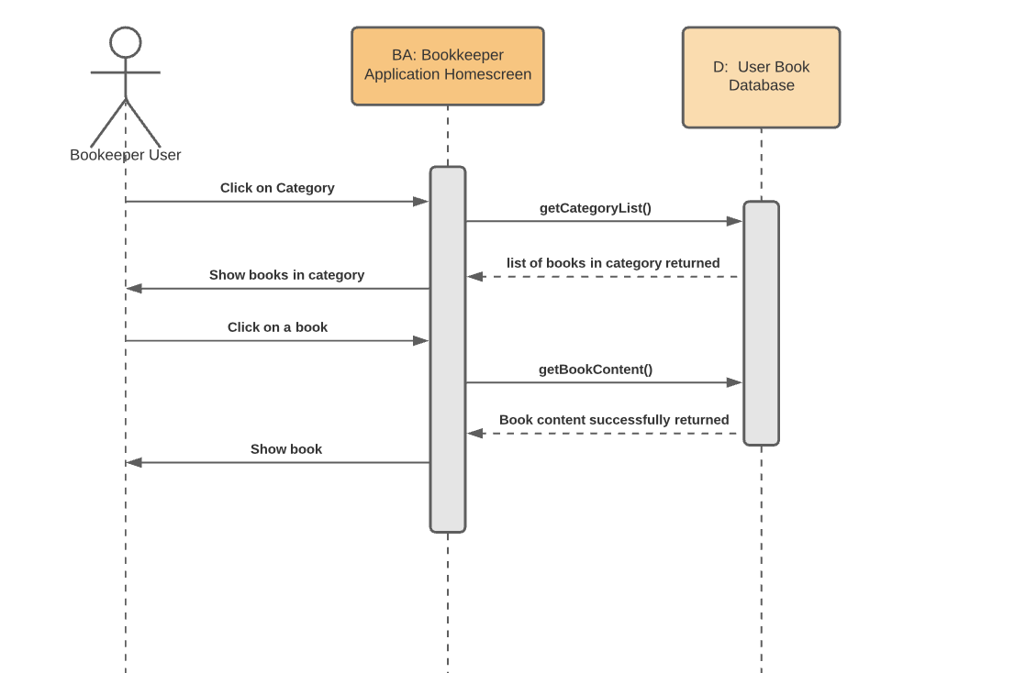
Sequence Diagram: View Book

Slide 14

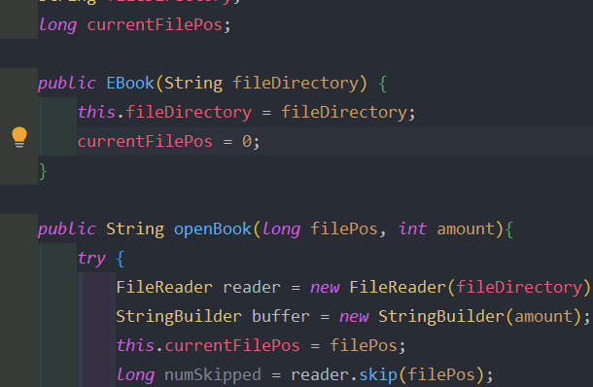
Test Plan
Book Reading Unit
Read a text file (.txt, .doc,...) into a Book Object
Technique: JUnit Testing
Method: Java's assertEquals
Test Unit Input:
FilePosition to start
Amount of characters to read
Test Unit Output: the x amount of characters from the input text file.
Notes:
For our Testing we made an Ebook class in java and added the basic parameters that are needed for an eBook.
Assuming that the books file directory is valid, the function openBook is being tested to see if it will it accurately return the text contents when given a starting file position and an amount to read.
This structure is what will be used to open pages of a book, since to get a page you just take the pages starting position in the file + the amount of characters you want on the page.
openBook is going to be tested using Javas Junit Testing class, and its asserEquals method specifically, to see if it can successfully read the first 25 characters from an input file.

Slide 15
Test Plan
Input: The quick brown fox jumps over the lazy dog
First 25 characters: The quick brown fox jumps
Successful case
Failure case
Assert when the first JUnit output is "The quick brown fox"
Assert when the first JUnit output is "The quick brown fox jumps"

Slide 16
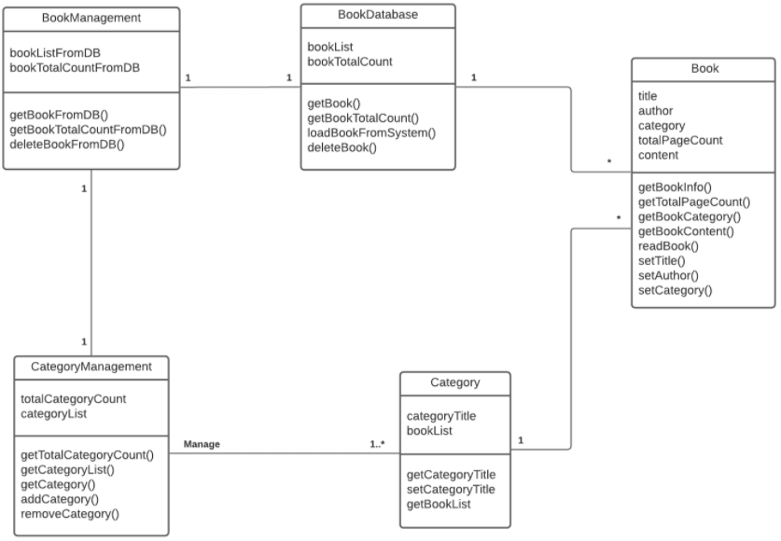

Class Diagram

Slide 17
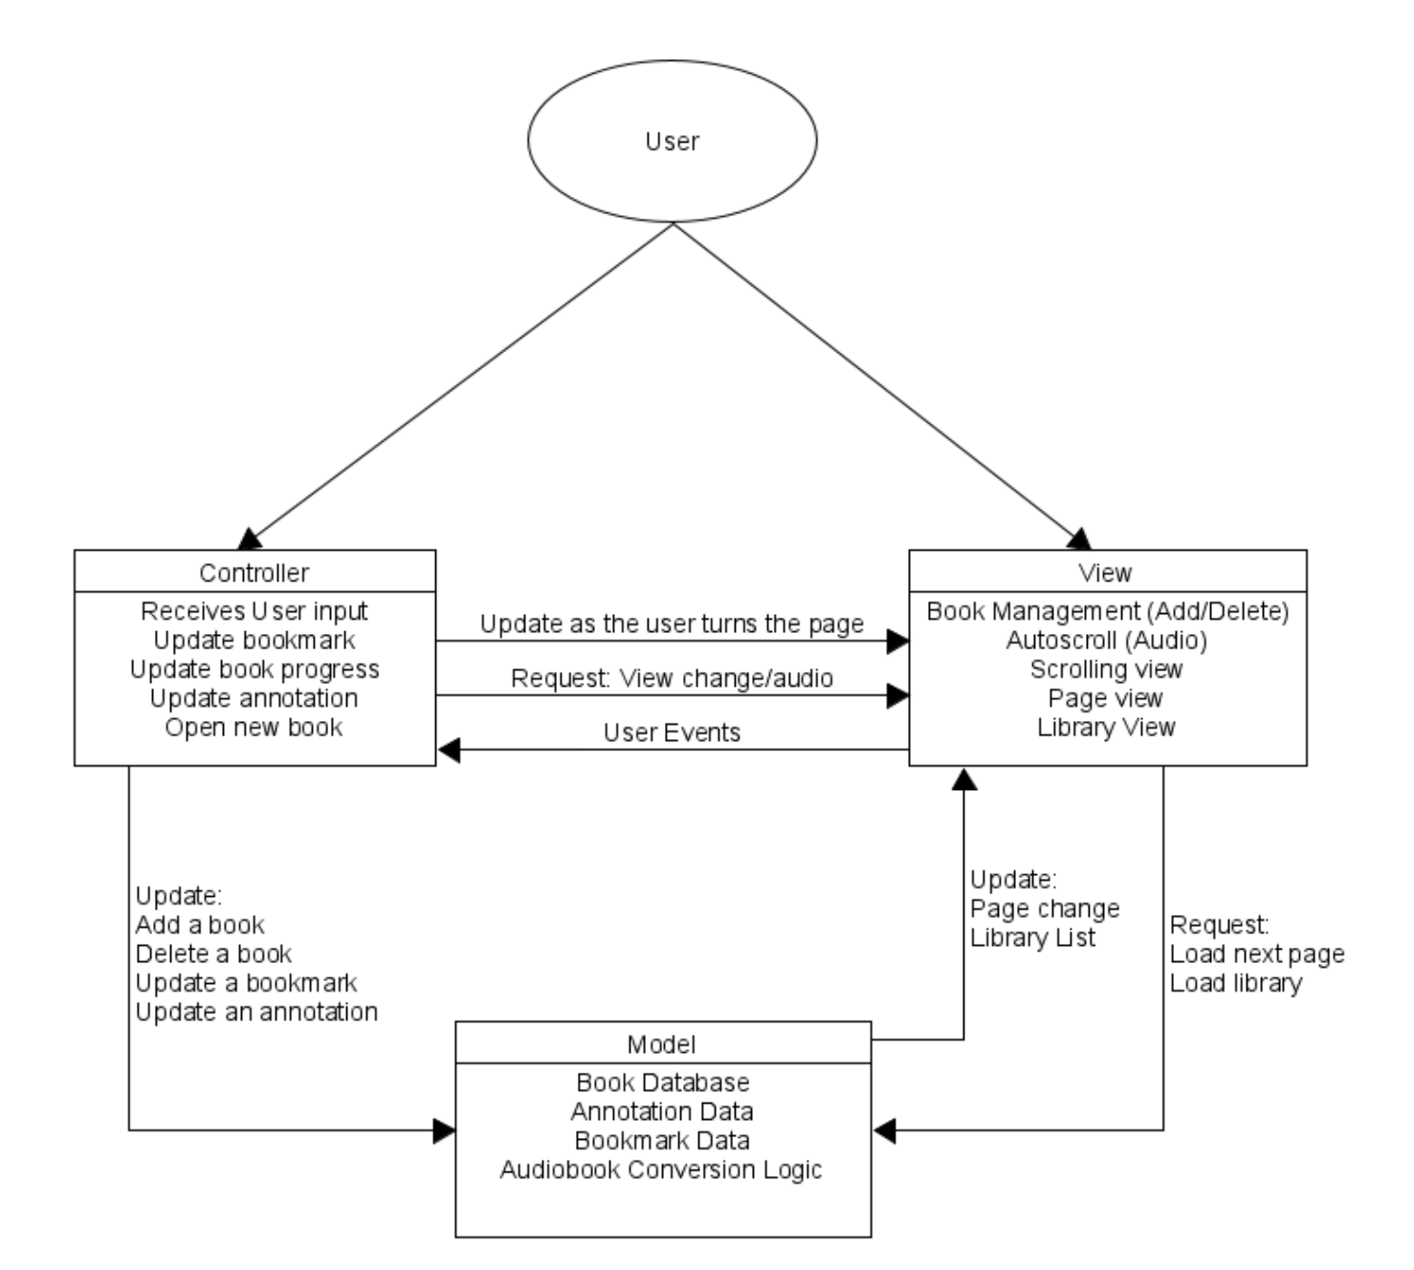
Architectural Design
Model View Controller Design
Extensibility and Flexibility of MVC design's division of features into components is best suited for bookreader.
Model is Book Database. View contains presentation of book. And controller respond to User events.

Slide 18
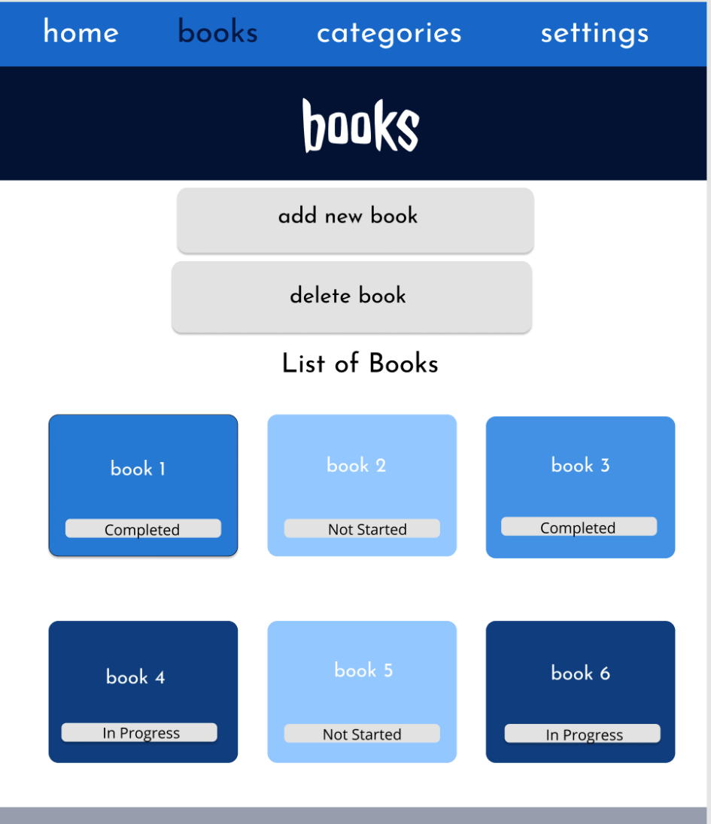
User Interface Design Comparison

Slide 19
Conclusion and Future Work
Eliminated the login requirement
Added a backup feature to backup data at regular intervals
Online integration will be added in an update
Application found a niche by emphasizing accessibility and simplicity
Future changes include cross-platform synchronization, and online book buying
Notes:
Through our research we decided that the most viable niches our product could fill were in accessibility and ease of use
We eliminated an account requirement because our application does not have high security requirements and is intended to be used on single user devices
We added a feature to backup the user’s books and bookmarks to protect against data loss from crashing and because user convenience was a high priority
We pushed online features, such as online book buying and cross-device synchronization into the future because while valuable, we felt it was more necessary to focus on fine tuning core functionality in the first version

Slide 20
Questions?
Vaibhav Sharma
Junior, Computer Science
Vaibhav.Sharma@UTDallas.edu
Jonathan Wachholz
Senior, Computer Science
Jhw190002@UTDallas.edu
Shreya Gazawada
Sophomore, Computer Science
Shreya.Gazawada@UTDallas.edu
Miranda Flemming
Junior, Computer Science
Mdf180000@UTDallas.edu
Danh Vo
Junior, Computer Science
DXV180004@UTDallas.edu
Luca DeJesu
Junior, Computer Science
Lgd170030@utdallas.edu
Andy Shao
Senior, Computer Science
Aqs170130@utdallas.edu
Notes:
We hope you enjoyed seeing what we have in store with Bookkeeper, if you have further inquiries, our team will happily answer your emailed questions.
Thank you for attending

